Slide 1
Deep Convolutional Neural Network for Real Time Visual Inspection of Structural Audit
Aditya Shenoy – 161080036
Rahul Bhoir – 161080063
Kalyani Borkar – 171081990
Rani Deore – 171081993

Slide 2
Abstract

Slide 3
Key Points
Structural audit requires manual expertise of surveyors that can be subjective and erroneous
Digital Image Processing needs to be hardcoded and Deep Learning has been applied for only crack detection
There is a need for a single generalized model, which can classify more than one structural defect during the visual inspection of structural audit

Slide 4
Key Points (Cont.)
The proposed system classifies cracks, dampness and paint peel-off using a single generalized model as a part of visual inspection while doing structural audit of infrastructures
The contribution of this work is 95% overall accuracy, 95% average precision, 95.25% average recall, and 95% average F1-score
Usage of a non-complex model has reduced the time taken for training the model and getting predictions from the model

Slide 5
Introduction

Slide 6
Background
Construction of different infrastructures is a necessity for human life
Old buildings show cracks, paint peel off, and dampness
Buildings need to be audited after 30 years
Visual inspection for detection of cracks, dampness, paint peel off totally depends on the surveyor’s experience and knowledge
There may be human errors

Slide 7
Literature Review

Slide 8
Digital Image Processing
MESG algorithm is use for enhancing the noisy image
SOBEL filter is used for obtaining binary image
CANNY edge detection is used for feature extraction
HMRF-EM algorithm is used to increase the accuracy to label the data
Particularly good accuracy for detection crack (up to 90% accuracy)
Numerous algorithm available for usage: grouping different algorithms can be used to detect crack.
Grouping of Algorithms for one problem cannot be used for another problem

Slide 9
Deep Learning for Crack Detection
Deep Convolutional Neural Network (DCNN) is capable to sense the crack robustly while dealing with complicated background images
Hessain matrix based linear filtering approach used to increase crack area and regulate threshold gap to get crack binarization segmentation result.
Using Internet of Things (IoT) technology for collecting video data is easy and solves the problems of high risk factor in domestic and low fracture analysis.
Genetic Algorithm for CNN model evolved several parameters that dictate the structure of CNN

Slide 10
Structural Audit
Overall health examination of a building to ensure its safety
It identifies parts of a building that may be in need of immediate repair, renovation or replacement
Should be conducted once in 5 years for 15-30 years old buildings
Should be conducted once every 3 years for 30+ years old buildings
A structural audit is a highly recommended preventive measure to avoid any calamitous eventualities altogether

Slide 11
Deep Learning on Video Images
Using Full Convolution Network (FCN) enables pixel level classification
Temporal features of subsequent frames can be captured using Convolutional Long Short Term Memory (Conv-LSTM)
Faster Region-based Convolutional Neural Network (R-FCN) gives better accuracy results
You Look Only Once (YOLO) processes the input faster and can be used in real time classification

Slide 12
Problem Statement
There is a need for a single generalized model, which can classify more than one structural defect during the visual inspection of structural audit

Slide 13
Proposed Solution

Slide 14
Proposed System
The proposed system classifies cracks, dampness and paint peel-off using a single generalized model as a part of visual inspection while doing structural audit of infrastructures

Slide 15
Transfer Learning
Transfer learning is a research problem in machine learning that focuses on storing knowledge gained while solving one problem and applying it to a different but related problem

Slide 16
ResNet-50 Model Architecture

Slide 17
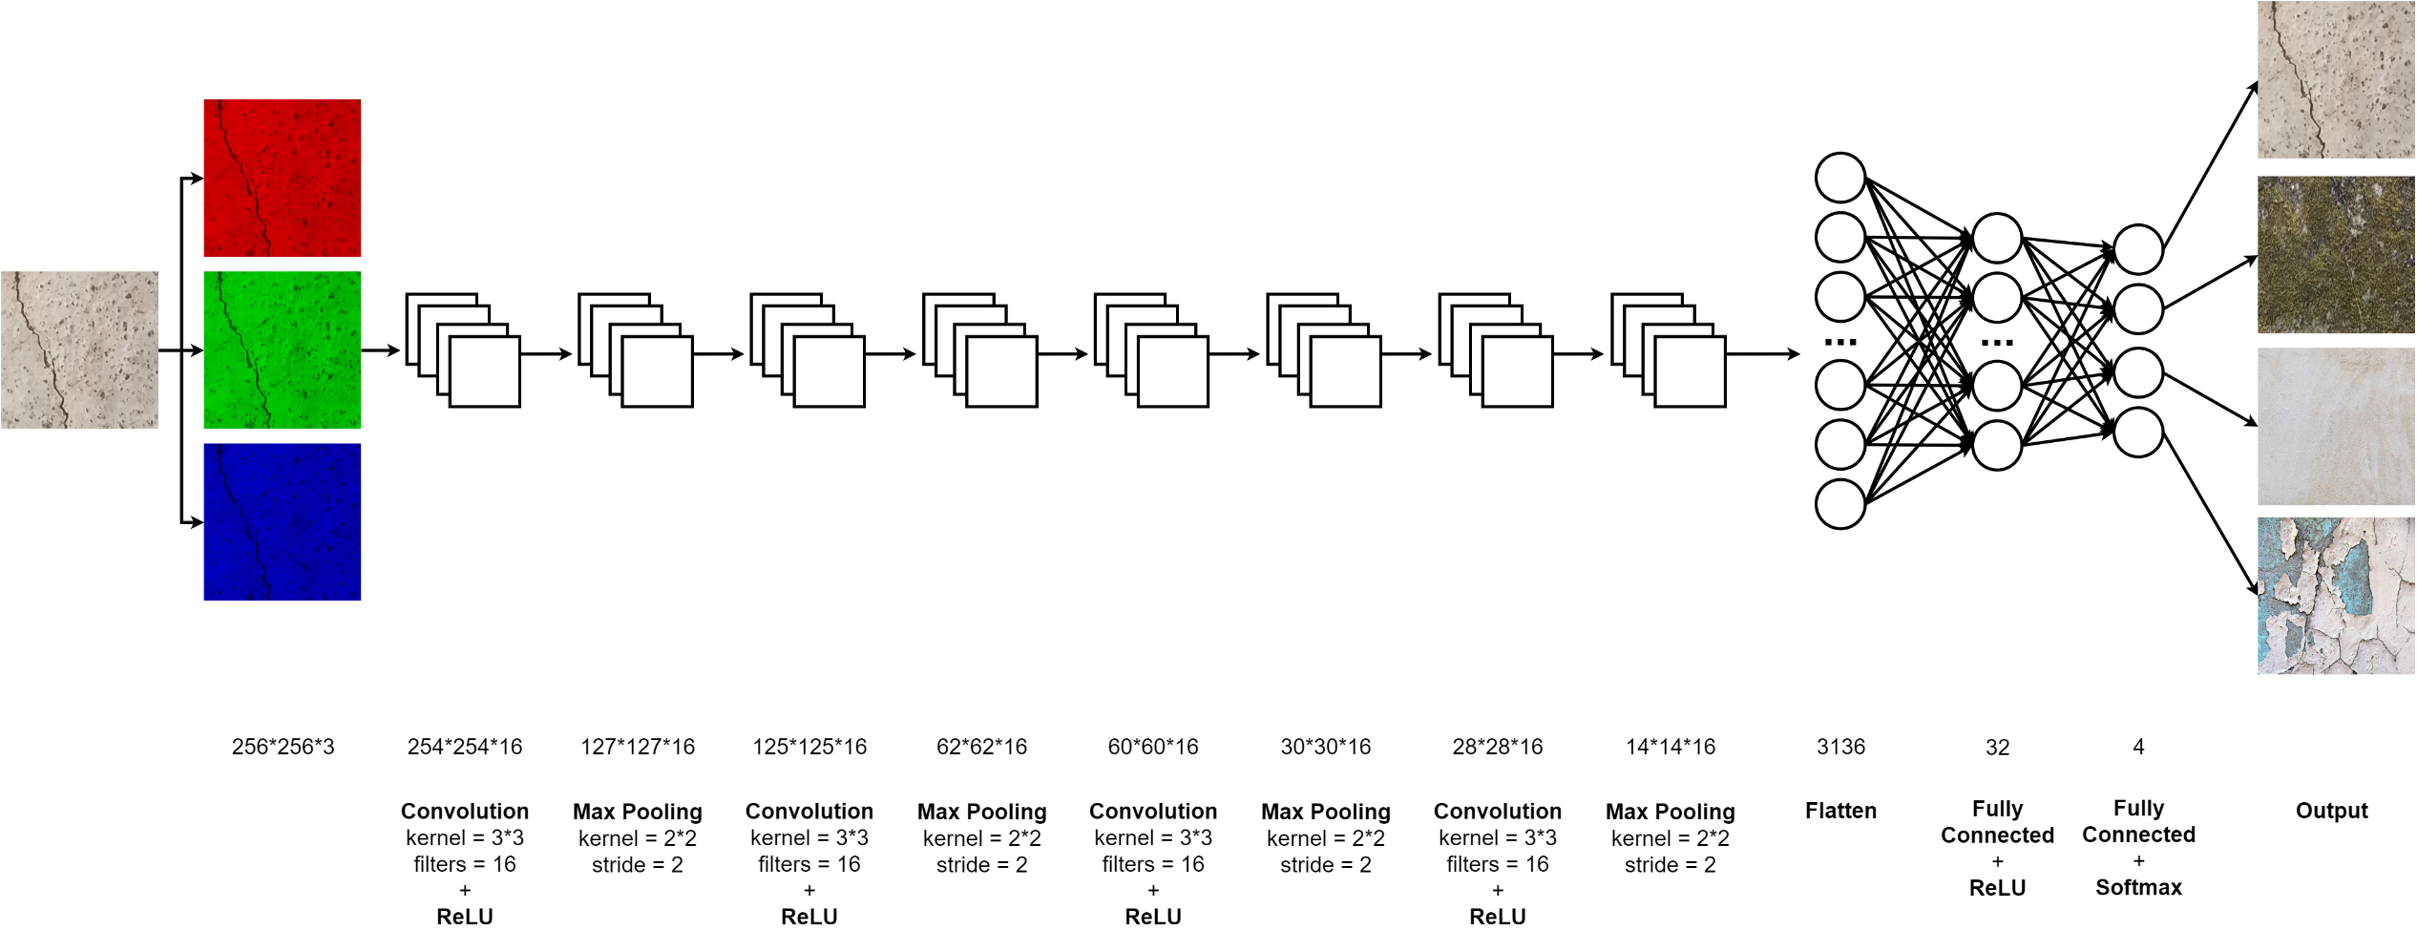
Effective Defect Classifier (EDC)

Slide 18
Sliding Window Mechanism
The video is divided into frames and each frame is divided into grids
Each sub-image in the grid is passed to the model for prediction
The predictions are then color coded
The color coded result is pasted along with the original video frames

Slide 19
Results and Analysis

Slide 20
Dataset
4 Classes – Crack, Dampness, Paint Peel Off, Plain Wall
Image Dimensions – 256*256
Training Size – 32,000
Testing Size – 4,000
Non Distorting Transformations – 7
Distorting Transformations – 2

Slide 21
Transfer Learning
ResNet-50 is not similar to our problem
Validation accuracy of the model trained was very poor
9 out of 10 images were incorrectly classified.

Slide 22
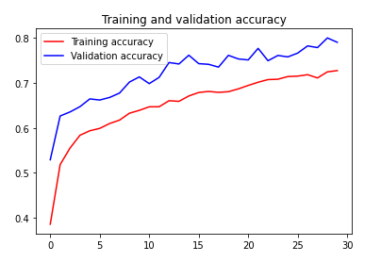
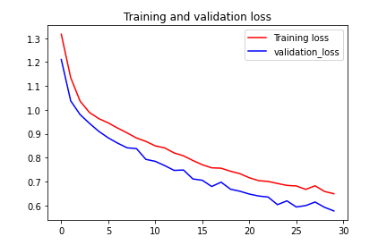
Transfer Learning Model Accuracy and Loss

Slide 23
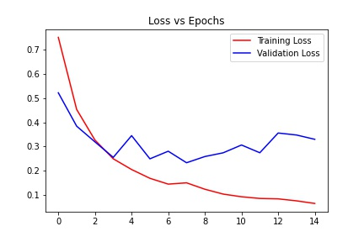
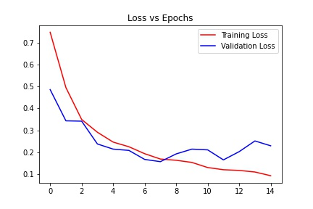
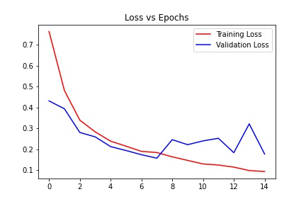
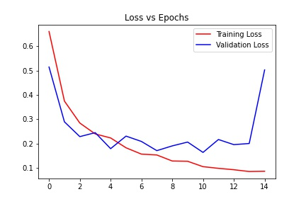
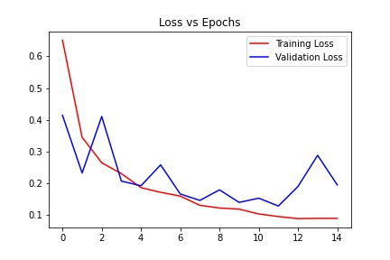
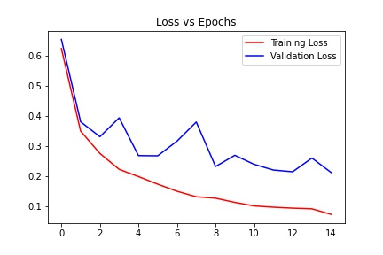
EDC - Train and Test Split Ratio
65:35
70:30
75:25
80:20
85:15
90:10

Slide 24
EDC – Confusion Matrix
Predicted→ Actual↓ | C | D | N | P | Total
C | 932 | 27 | 13 | 28 | 1000
D | 16 | 966 | 8 | 10 | 1000
N | 8 | 10 | 957 | 25 | 1000
P | 24 | 11 | 19 | 946 | 1000
 | C | Not C
C | TP = 932 | FN = 68
Not C | FP = 48 | TN = 2952
 | D | Not D
D | TP = 966 | FN = 34
Not D | FP = 48 | TN = 2952
 | N | Not N
N | TP = 957 | FN = 43
Not N | FP = 40 | TN = 2960
 | P | Not P
P | TP = 946 | FN = 54
Not P | FP = 43 | TN = 2957
C – Crack | D – Dampness | N – Plain Wall | P – Paint Peel Off

Slide 25
EDC – Metrics
Training Time – 77.6 seconds per epoch on an average
Accuracy – 95%
 | Precision | Recall | F1-Score | Total
Crack | 0.95 | 0.93 | 0.94 | 1000
Dampness | 0.95 | 0.97 | 0.96 | 1000
Plain Wall | 0.96 | 0.96 | 0.96 | 1000
Paint Peel Off | 0.94 | 0.95 | 0.94 | 1000

Slide 26
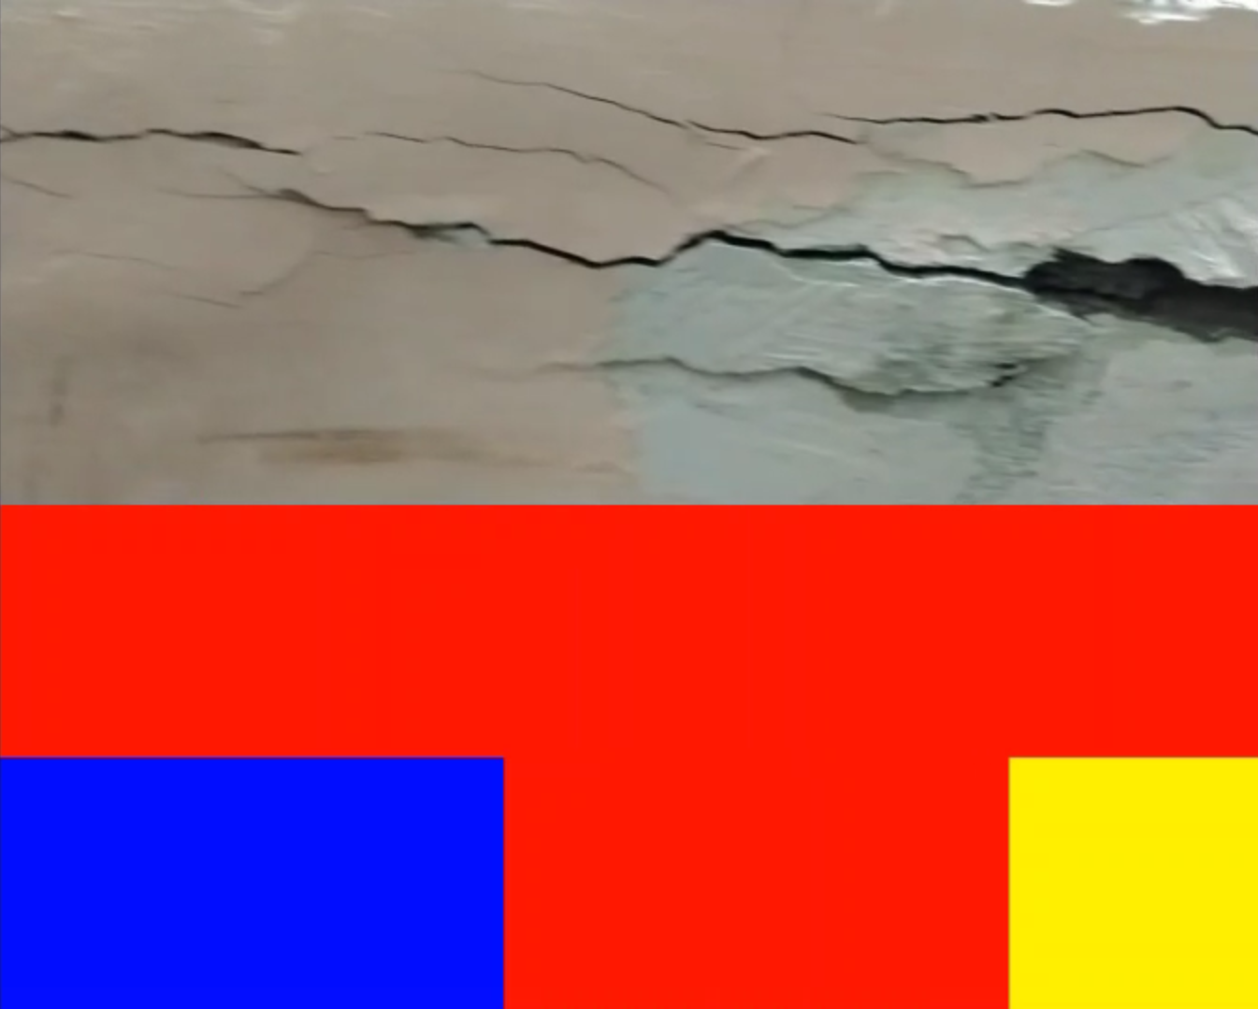
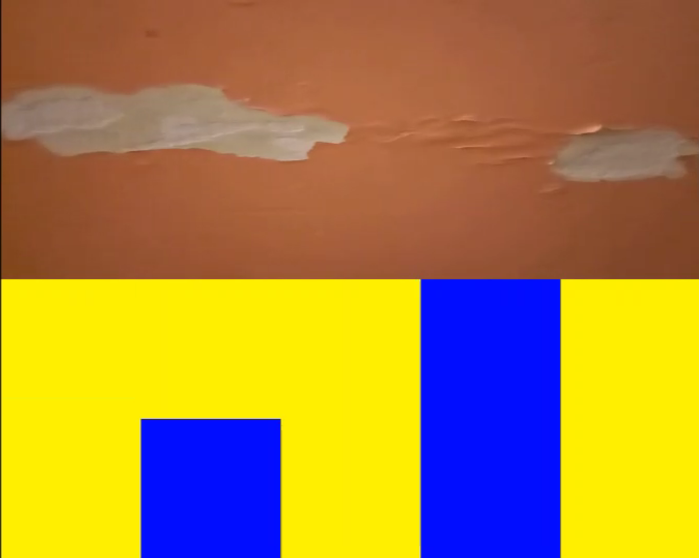
Sliding Window Output Frames
a
Red – Crack | Green – Dampness | Blue – Plain Wall | Yellow – Paint Peel Off

Slide 27
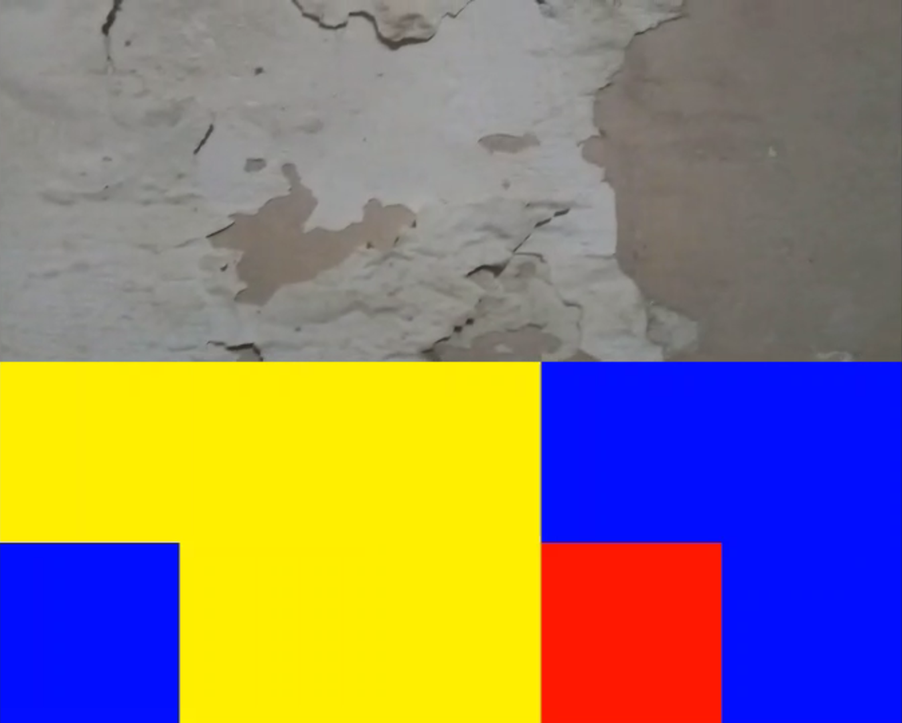
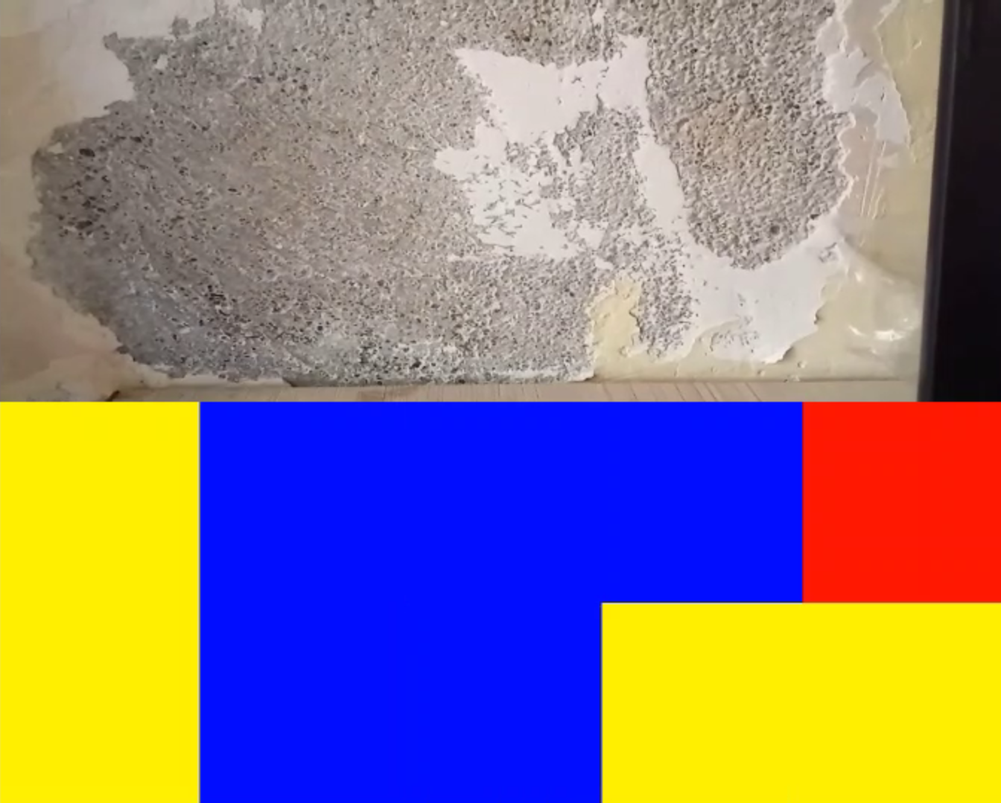
Sliding Window Output Frames Cont.
a
Red – Crack | Green – Dampness | Blue – Plain Wall | Yellow – Paint Peel Off

Slide 28
Conclusion and Future Scope

Slide 29
Conclusion
EDC classifies more labels than existing models
Use of non complex model has reduced training and prediction times
Average metric for Accuracy, Precision, Recall, and F1-Score is 95%

Slide 30
Future Scope
Dataset size can be increased by doing more surveys
More types of defects can be incorporated into the model
Pre-processing techniques can be applied to get more features from images

Slide 31
Appendix

Slide 32
Training Time History
Epochs | Training Time (sec) | Epochs | Training Time (sec)
1 | 80 | 9 | 77
2 | 80 | 10 | 77
3 | 78 | 11 | 77
4 | 78 | 12 | 77
5 | 78 | 13 | 77
6 | 77 | 14 | 77
7 | 77 | 15 | 77
8 | 77 | - | -
Avg. Training Time per Epoch |  | 77.6 seconds
Total Training Time for 15 Epochs |  | 19 minutes 24 seconds

Slide 33
Accuracy and Loss History
Epochs | Training Accuracy (%) | Validation Accuracy (%) | Training Loss | Validation Loss
1 | 70.36 | 71.95 | 0.71 | 0.70
2 | 85.69 | 91.30 | 0.39 | 0.35
3 | 90.88 | 92.90 | 0.29 | 0.22
4 | 92.09 | 90.68 | 0.25 | 0.30
5 | 92.60 | 92.37 | 0.21 | 0.22
6 | 93.79 | 91.15 | 0.19 | 0.28
7 | 93.74 | 93.15 | 0.17 | 0.21
8 | 95.06 | 93.48 | 0.17 | 0.23

Slide 34
Accuracy and Loss History (Cont.)
Epochs | Training Accuracy (%) | Validation Accuracy (%) | Training Loss | Validation Loss
9 | 95.06 | 94.67 | 0.13 | 0.17
10 | 95.12 | 94.35 | 0.13 | 0.24
11 | 95.51 | 93.48 | 0.12 | 0.27
12 | 96.16 | 94.23 | 0.10 | 0.20
13 | 96.57 | 95.15 | 0.09 | 0.23
14 | 96.41 | 94.92 | 0.10 | 0.24
15 | 97.12 | 95.07 | 0.08 | 0.26

